Slide 1


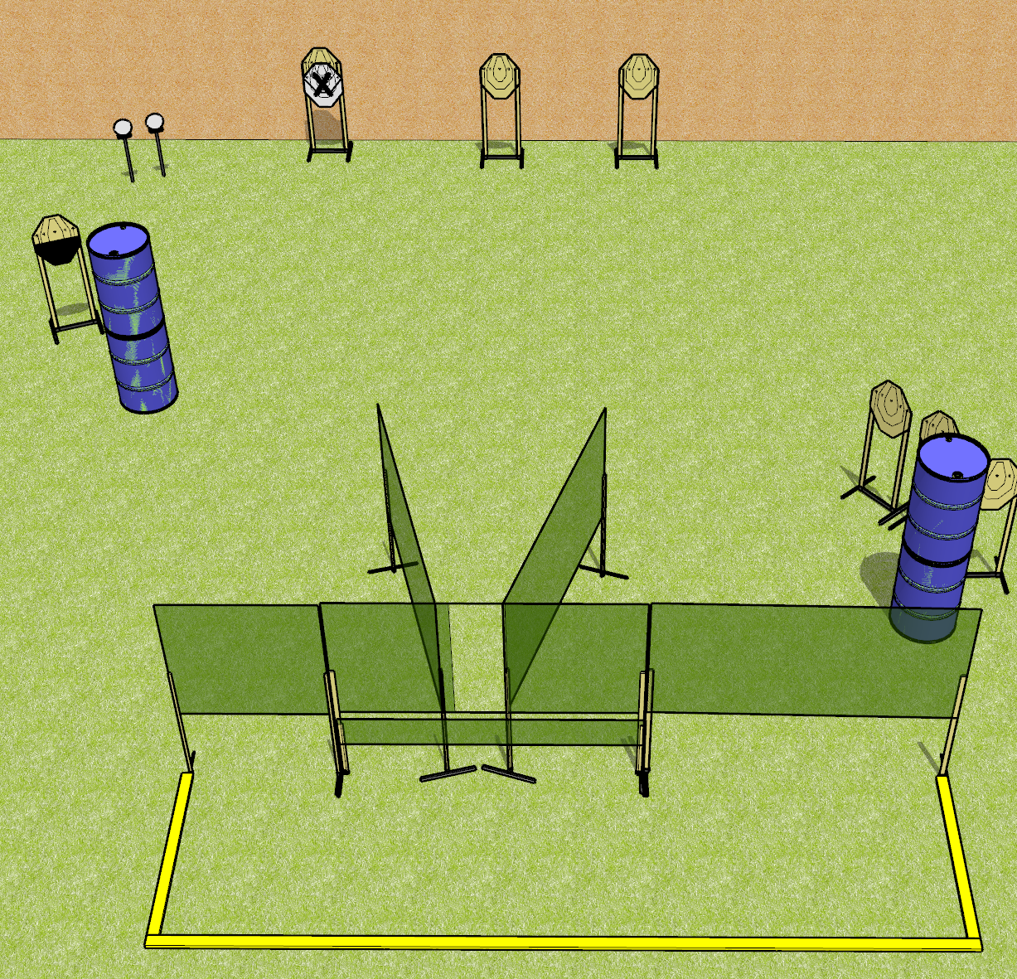
 | Dothan Gun Club – USPSA Match Down and Dirty Course Designer : Drew Coleman
Round Count 16 rounds 7 IPSC 2 plates
Equipment List 10 wall feet 2 medium fault lines 1 half IPSC

Slide 2
Down and Dirty
Written Stage Briefing
Down and Dirty is a 16 round, 80 point, Comstock course of fire. There are 7 ISPC targets and 2 plates. The best 2 hits on paper will score and steel must fall to score. The start signal is audible.
Handgun start position is anywhere completely outside the shooting area, wrists below belt. Handgun is loaded and holstered.
PCC start position is anywhere completely outside the shooting area, stock on belt. Loaded carbine is held with both hands, safety on.
On start signal, engage targets as they become available from within the shooting area.

Slide 3
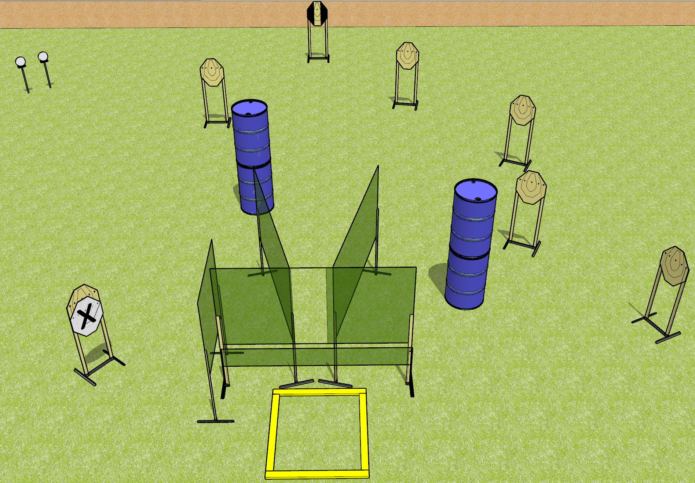
 | Dothan Gun Club – USPSA Match Frag Hurts Course Designer : Drew Coleman
Round Count 16 rounds 8 IPSC 2 plates
Equipment List 8 wall feet 1 outer limits box 1 tuxedo

Slide 4
Frag Hurts
Written Stage Briefing
Frag Hurts is a 16 round, 80 point, Comstock course of fire. There are 8 IPSC targets and 2 falling plates. The best 2 hits on paper will score, and steel must fall to score. The start signal is audible.
Handgun start position is anywhere outside the shooting area, wrists below belt. Handgun is loaded and holstered.
PCC start position is anywhere outside the shooting area, stock on belt. Loaded carbine is held with both hands.
On start signal, engage targets as they become available from within the shooting area.

Slide 5
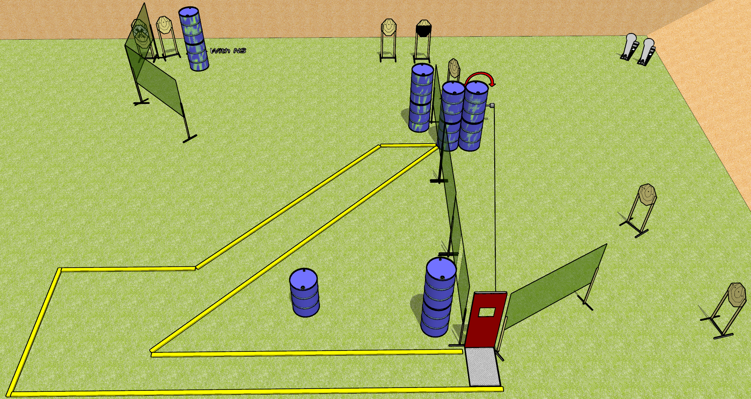
 | Dothan Gun Club – USPSA Match Middle of Nowhere Course Designer : Drew Coleman
Round Count 22 rounds 10 IPSC 2 colt poppers
Equipment List 10 wall feet Barricade with pull port Swinger + activator 1 50%

Slide 6
Middle of Nowhere
Written Stage Briefing
Middle of Nowhere is a 22 round, 110 point, Comstock course of fire. There are 10 IPSC targets and 2 colt poppers. The best 2 hits on paper wills core, and steel must fall to score. The start signal is audible.
The swinger is activated by the pull cord and remains visible at rest.
Handgun start position is inside the shooting area. Handgun is loaded on barrel.
PCC start position is inside the shooting area. Loaded carbine is placed on barrel.
On start signal, engage targets as they become available from within the shooting area.

Slide 7
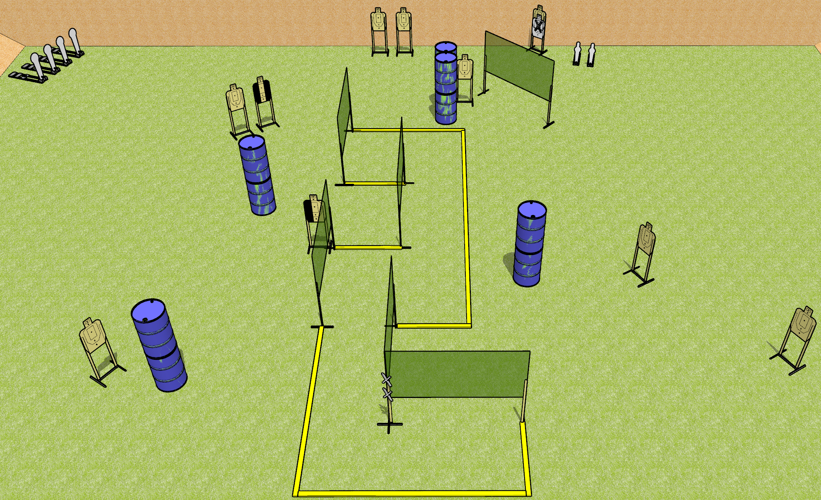
 | Dothan Gun Club – USPSA Match Keyway Course Designer : Drew Coleman
Round Count 26 rounds 10 USPSA targets 4 colt poppers, 2 mini poppers
Equipment List 11 wall feet 4 medium fault lines 1 tuxedo, 1 left hard cover

Slide 8
Keyway
Written Stage Briefing
Keyway is a 26 round, 130 point, Comstock course of fire. There are 10 USPSA targets, 4 colt poppers, and 2 mini poppers. The best 2 hits on paper will score and steel must fall to score. The start signal is audible.
Handgun start position is both hands touching marks. Handgun is loaded and holstered.
PCC start position is muzzle touching lower mark. Loaded carbine is held with both hands.
On start signal, engage targets as they become available from within the shooting area.

Slide 9
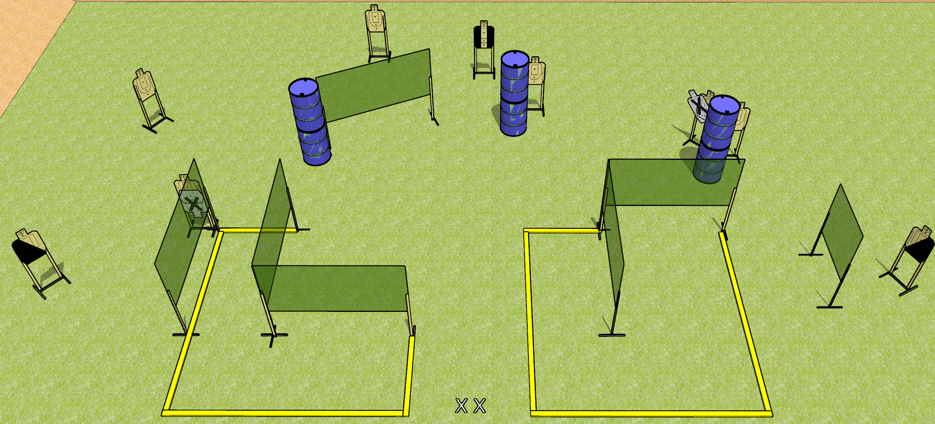
 | Dothan Gun Club – USPSA Match Box Me Up Course Designer : Drew Coleman
Round Count 27 rounds 9 USPSA targets
Equipment List 12 wall feet 4 medium fault lines 2 diagonal, 1 tuxedo

Slide 10
Box Me Up
Written Stage Briefing
Box Me Up is a 27 round, 135 point, Comstock course of fire. There are 9 USPSA targets. The best 3 hits on paper will score. The start signal is audible.
Handgun start position is both feet on X’s, wrists below belt. Handgun is unloaded and holstered.
PCC start position is both feet on X’s, stock on belt. Unloaded carbine is held with both hands.
On start signal, engage targets as they become available from within the shooting area.

Slide 11
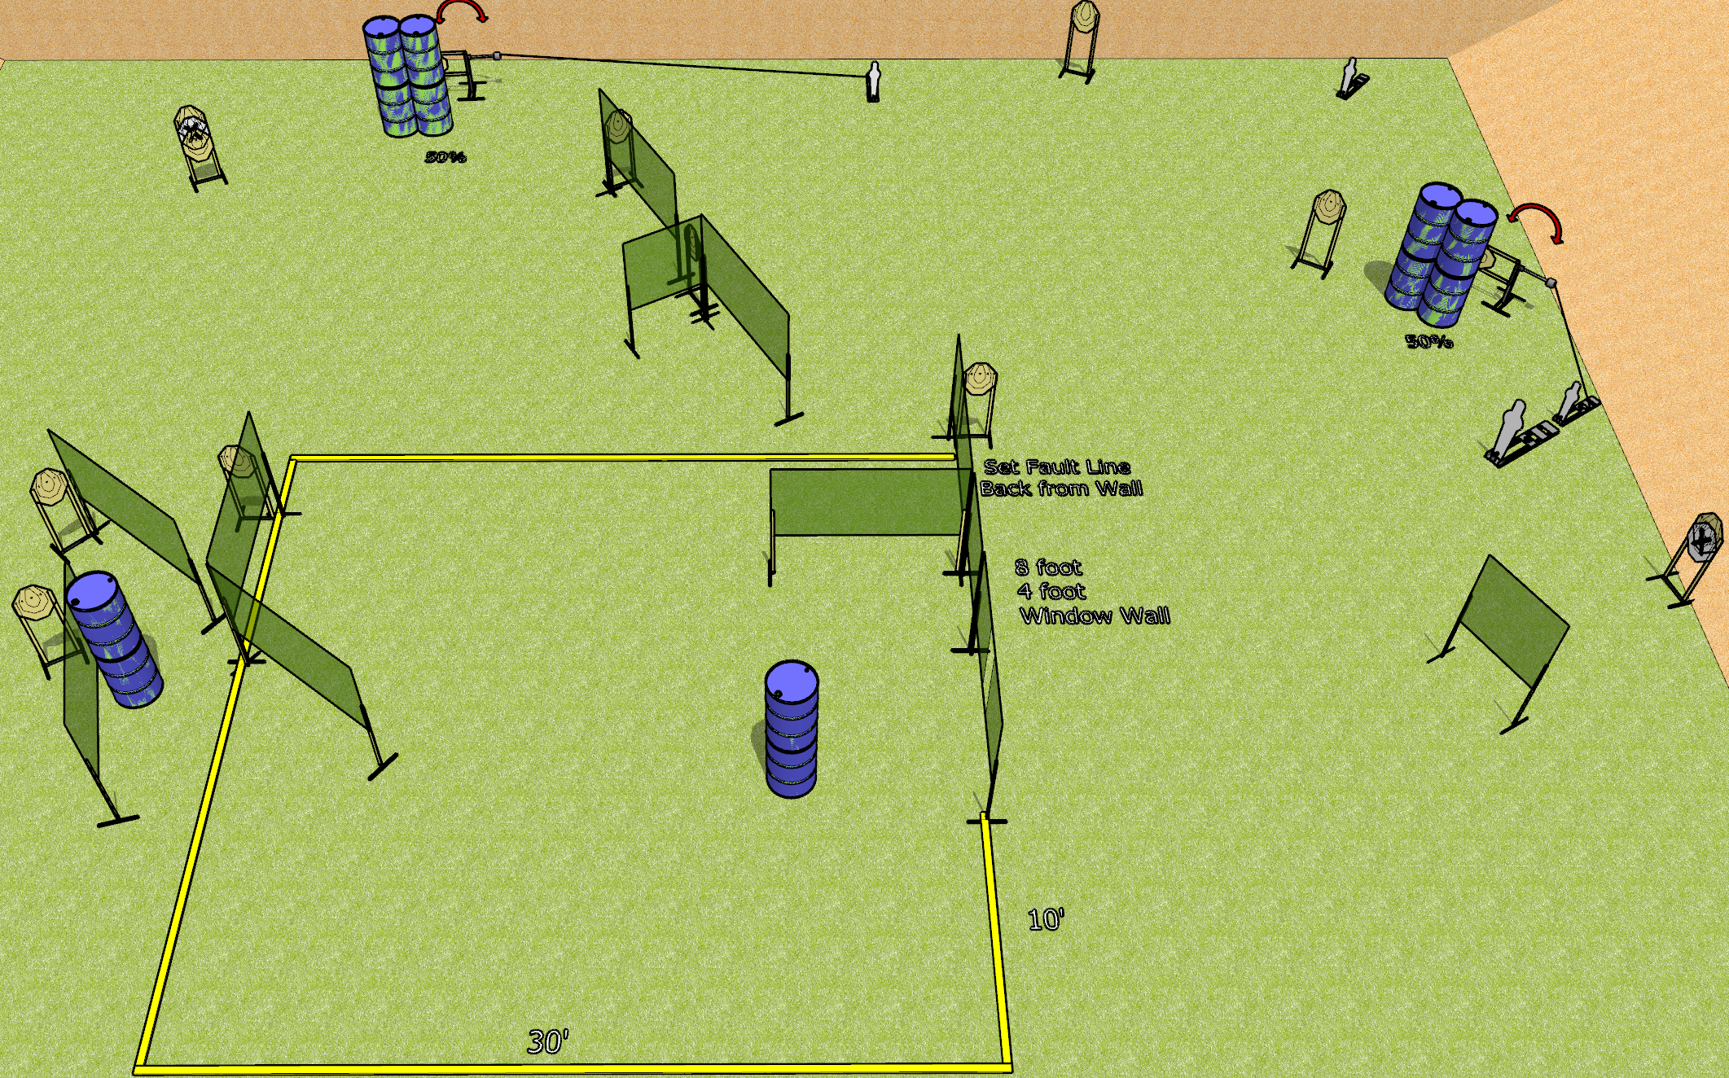
 | Dothan Gun Club – USPSA Match Gone Crazy Course Designer : Drew Coleman
Round Count 30 rounds 13 IPSC 3 mini poppers, 1 pepper popper
Equipment List 2 swingers + activators 21 wall feet 1 tuxedo, 2 50% (on swingers)

Slide 12
Gone Crazy
Written Stage Briefing
Gone Crazy is a 30 round, 150 point, Comstock course of fire. There are 13 IPSC targets, 3 mini poppers, and 1 pepper popper. The best 2 hits on paper will score, and steel must fall to score. The start signal is audible.
Left swinger is activated by the mini popper closest to it. Right swinger is activated by the mini popper behind the pepper popper. Both swingers are visible at rest.
Handgun start position is toes touching the frontmost fault line, wrists below belt. Handgun is loaded and holstered.
PCC start position is toes touching the frontmost fault line, stock on belt. Loaded carbine is held with both hands safety on.
On start signal engage the targets as they become available from within the shooting area.

